Slide 1
Musical Genre Classification using Melodic Features and Source Separated Audio from Polyphonic Signals
Dhaivat Shah
ds3267@columbia.edu

Slide 2
Introduction
Musical Genre
The term used to describe music that has similar properties, in those aspects of music that differ from the others
Melody
The single (monophonic) pitch sequence that a listener might reproduce if asked to whistle or hum a piece of polyphonic music.
Pitch
Perceptual property that allows the ordering of sounds on a frequency-related scale.
Polyphany
Texture consisting of two or more simultaneous lines of independent melody, as opposed to music with just one voice (monophony) or music with one dominant melodic voice accompanied by chords (homophony).
Source Separation
Estimation of main melody from a polyphonic signal.

Slide 3
Problem Definition
Given an audio signal, classify it into previously known categories.
Given many audio signals, cluster them into similar genres.
Applications
Casual Users: Listening to similar kinds of music
Academic/Professional users: Finding related sequences to analyze and study
Music industry: Efficient retrieval and storage
Issues
While this comes naturally to people, it is quite difficult programmatically, due to polyphony.
Why not let people do it?
With the volume generated, it is simply impossible.

Slide 4
Approach
Polyphonic Signal
Melody Estimation
Source Separated Audio
Feature Extraction
Feature Sets
Classification
Clustering
Melody Estimation
Feature Extraction
Classification

Slide 5
State of the Art
Proposed Techniques:
Temporal
Energy
Spectral Shape
Perceptual features
Slow Temporal modulations of music recordings and the sparse representation based classifiers.
Accuracy: 91%
Previous best: 82.5%
Pitch Based
50-60%
Synthetic Dataset: 90-95%

Slide 6
Melody Extraction Process

Slide 7
Source/Filter Model

Slide 8

Source Separation
Original
Solo

Slide 9
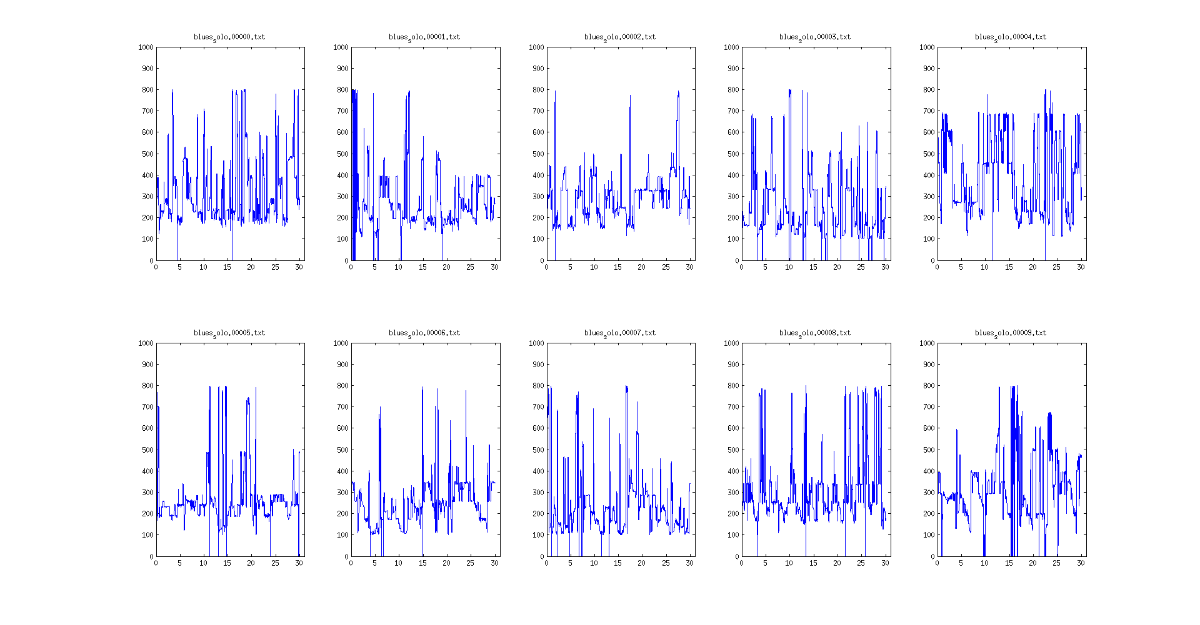
Pitch (F0) - blues

Slide 10
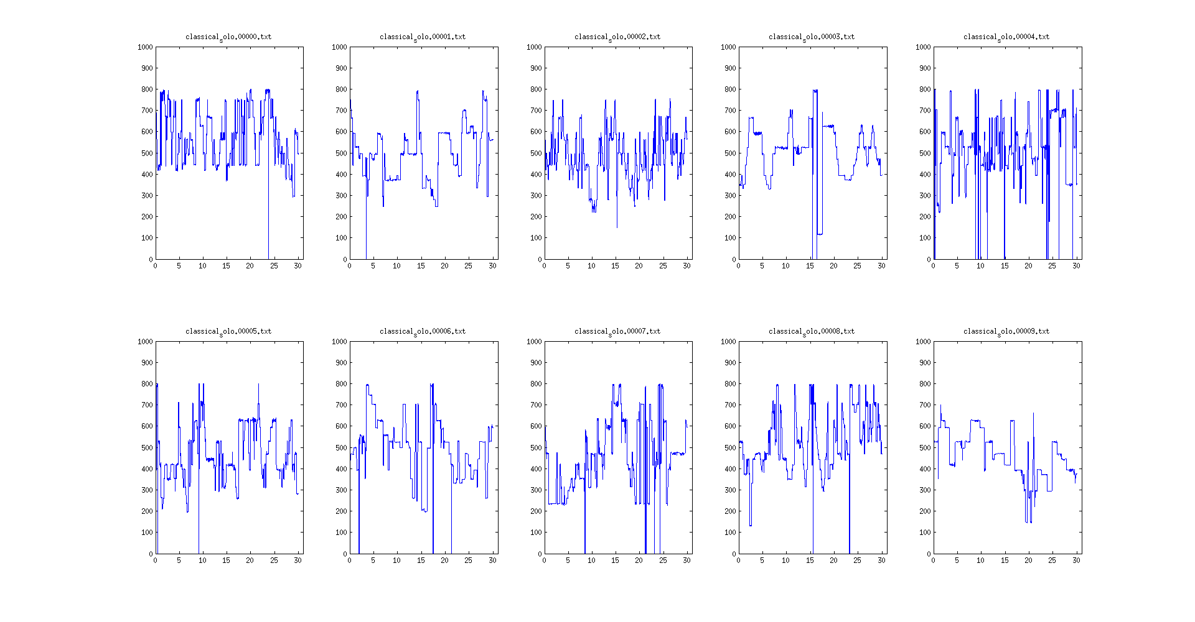
Pitch (F0) - classical

Slide 11
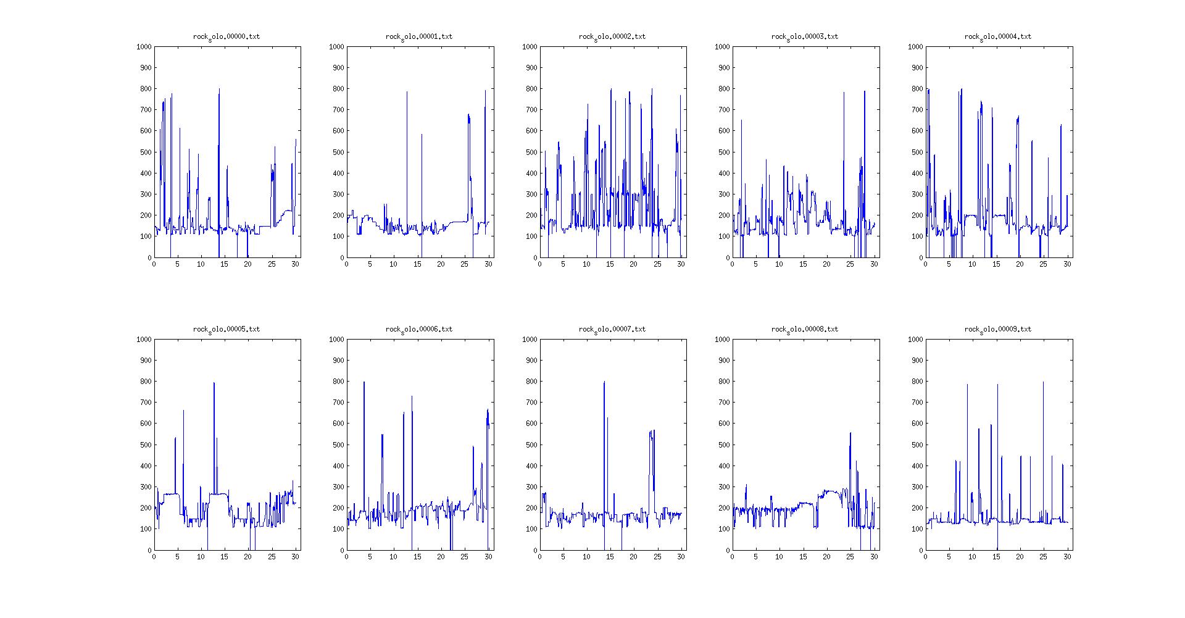
Pitch (F0) - rock

Slide 12
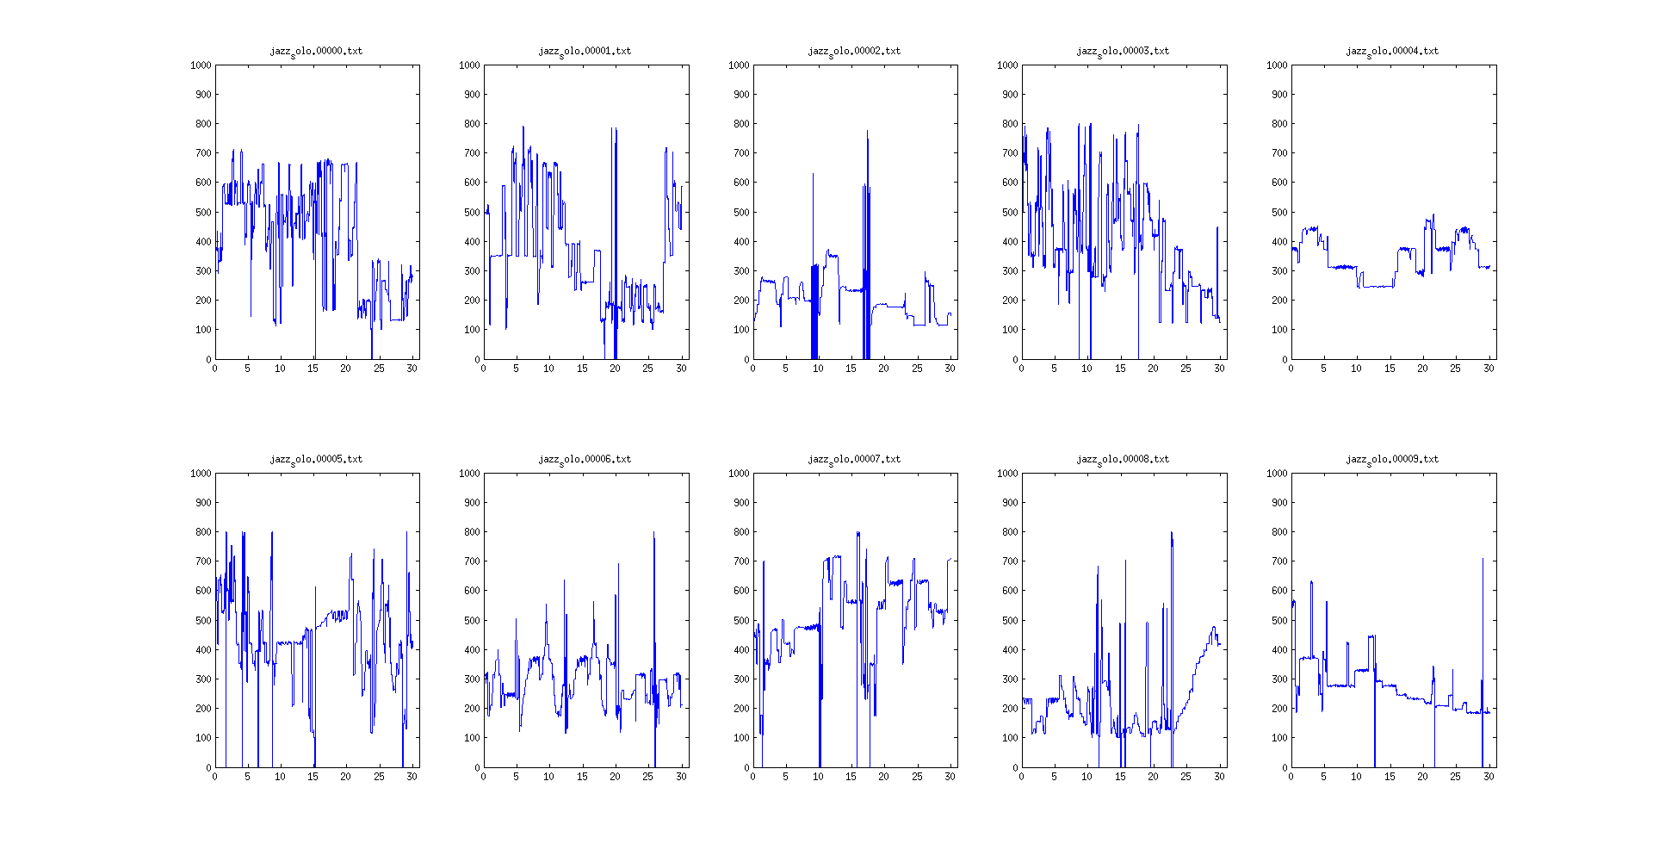
Pitch (F0) - Jazz

Slide 13
Feature Set
Pitch Based
Mean
Variance
Max
Min
Skewness
Kurtosis
Vibration
Mean
Variance
Others
MFCC
Combined

Slide 14
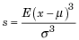
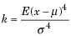
Features
Skewness
Skewness is a measure of the asymmetry of the data around the sample mean.
Kurtosis
Kurtosis is a measure of how outlier-prone a distribution is.
MFCC
Take the Fourier transform of (a windowed excerpt of) a signal.
Map the powers of the spectrum obtained above onto the mel scale, using triangular overlapping windows.
Take the logs of the powers at each of the mel frequencies.
Take the discrete cosine transform of the list of mel log powers, as if it were a signal.
The MFCCs are the amplitudes of the resulting spectrum.

Slide 15
Classification
K Nearest Neighbors (KNN) Classifier
An object is classified by a majority vote of its neighbors, with the object being assigned to the class most common among its k nearest neighbors
Value of k: depends on number of genres.
Gaussian Naive Bayes
Support Vector Machine Classifier (SVC) - ‘rbf’ kernel
Linear SVC - ‘linear’ kernel

Slide 16
Clustering
Technique:
K Nearest Neighbors (KNN)
Scores:
Homogeneity: each cluster contains only members of a single class.
Completeness: all members of a given class are assigned to the same cluster.
V-measure: Harmonic mean of the previous two measures.
Adjusted Rand index: Function that measures the similarity of the two assignments, ignoring permutations and with chance normalization.
Adjusted Mutual Information: is a function that measures the agreement of the two assignments, ignoring permutations.

Slide 17
Tools
Soxexam
au to wav format conversion
separateLeadStereo
Separate into solo, music parts – both GSMM and IMM
Estimate pitch values
python/matlab
numpy/scipy
Scikit Learn
Classification and Clustering
MFCC
Baseline calculation (Mean and Variance)

Slide 18
Dataset
GTZAN
The dataset consists of 1000 audio tracks each 30 seconds long.
It contains 10 genres, each represented by 100 tracks.
The tracks are all 22050Hz Mono 16-bit audio files in .au format.
Genres – Blues, Classical, Country, Disco, Hiphop
Jazz, Metal, Pop, Reggae, Rock
Processed
First 10 from each of the genres.
Total of 100 tracks.
ReducedSubset
Classical, Pop, Rock genres

Slide 19
Results – All Genres
Classification | KNN | Gaussian NB | Linear SVC | SVC
MFCC | 0.32 | 0.52 | 0.6 | 0.44
Pitch Solo | 0.28 | 0.36 | 0.22 | 0.22
Pitch Orig | 0.22 | 0.3 | 0.28 | 0.2
Combined Solo | 0.28 | 0.54 | 0.16 | 0.26
Combined Orig | 0.22 | 0.3 | 0.1 | 0.2
Clustering | Homogeneity | Completeness | V Measure | Adjusted Rand Score | Adjusted Mutual Info
MFCC | 0.411 | 0.437 | 0.424 | 0.173 | 0.262
Pitch Solo | 0.379 | 0.418 | 0.397 | 0.160 | 0.234
Pitch Orig | 0.343 | 0.412 | 0.374 | 0.122 | 0.203
Combined Solo | 0.372 | 0.416 | 0.393 | 0.134 | 0.228
Combined Orig | 0.350 | 0.401 | 0.374 | 0.128 | 0.207

Slide 20
Results – Specific Genres
Classification | KNN | Gaussian NB | Linear SVC | SVC
MFCC | 0.46 | 0.93 | 0.73 | 0.6
Pitch Solo | 0.46 | 0.93 | 1.00 | 0.8
Pitch Orig | 0.46 | 1.00 | 0.93 | 0.6
Combined Solo | 0.46 | 0.93 | 0.93 | 0.8
Combined Orig | 0.46 | 1.00 | 0.86 | 0.6
Clustering | Homogeneity | Completeness | V Measure | Adjusted Rand Score | Adjusted Mutual Info
MFCC | 0.389 | 0.441 | 0.413 | 0.340 | 0.342
Pitch Solo | 1.00 | 1.00 | 1.00 | 1.00 | 1.00
Pitch Orig | 1.00 | 1.00 | 1.00 | 1.00 | 1.00
Combined Solo | 1.00 | 1.00 | 1.00 | 1.00 | 1.00
Combined Orig | 1.00 | 1.00 | 1.00 | 1.00 | 1.00

Slide 21
Conclusion
The method proposed does not work great for all genres in general.
However, when used to classify or cluster genres suitable for the particular method, it performs way better than other approaches.
Extracting pitch from the source separated audio as compared to the original signal, provides better results in most cases.
Combining the features extracted with the standard MFCC features increases accuracy in most cases.
In a classification task, augmenting pitch features to the other suited features should provide promising results.

Slide 22
References
pyFASST – Jean-Louis Durrieu
Python implementation of the Flexible Audio Source Separation Toolbox
Slaney, Malcolm. "Auditory toolbox." Interval Research Corporation, Tech. Rep10 (1998): 1998.
http://marsyas.info/download/data_sets/
Salamon, Justin, Bruno Rocha, and Emilia Gómez. "Musical genre classification using melody features extracted from polyphonic music signals."Acoustics, Speech and Signal Processing (ICASSP), 2012 IEEE International Conference on. IEEE, 2012.
Durrieu, J-L., et al. "Source/filter model for unsupervised main melody extraction from polyphonic audio signals." Audio, Speech, and Language Processing, IEEE Transactions on 18.3 (2010): 564-575.
Sturm, Bob L. "An analysis of the GTZAN music genre dataset." Proceedings of the second international ACM workshop on Music information retrieval with user-centered and multimodal strategies. ACM, 2012.
Panagakis, Yannis, Constantine Kotropoulos, and Gonzalo R. Arce. "Music genre classification via sparse representations of auditory temporal modulations." Proc. European Signal Process. Conf., Glasgow, Scotland. 2009.

Slide 23
Thank You

